Slide 1
Thank you for serving as a Communications Chair this year!
Welcome to NCBarBlog

Slide 2
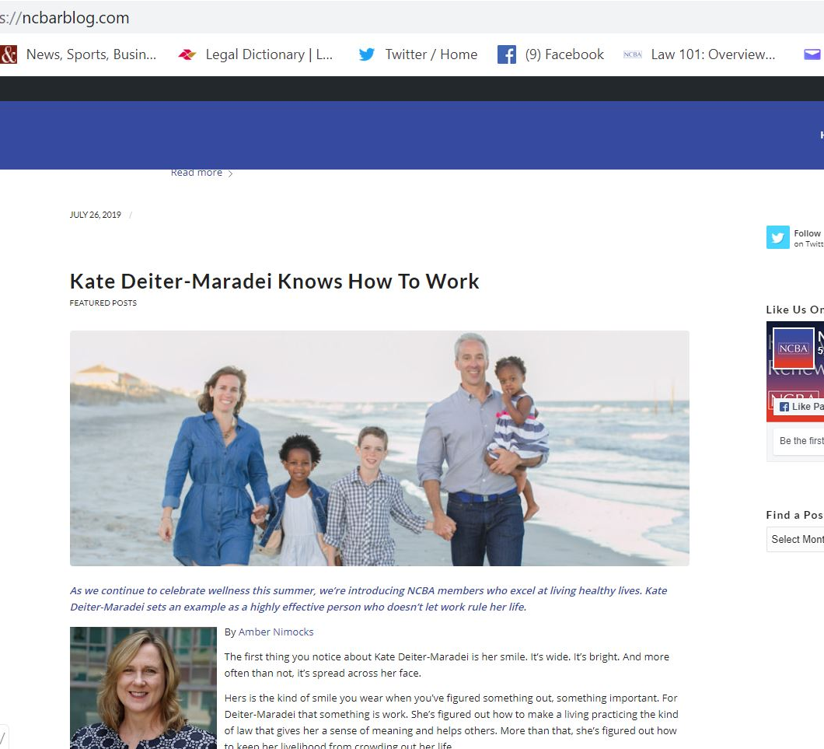
The Process
Our goal is to streamline and standardize the blog posting process for all Sections and Divisions.
Instead of emailing the Word document to the NCBA communications manager or your communities manager, please submit your content directly to the Word Press site, following the steps outlined here.

Slide 3
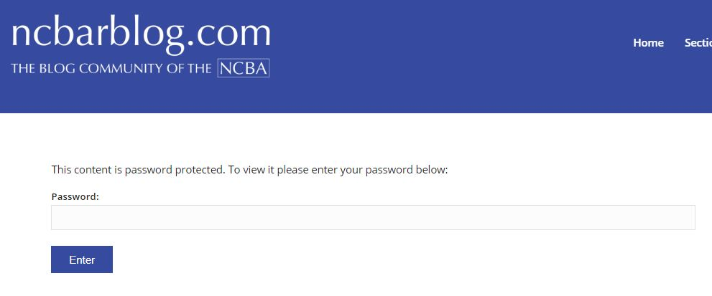
To post articles
Go to https://ncbarblog.com/commchairs/
Log in using the password commchairs.

Slide 4
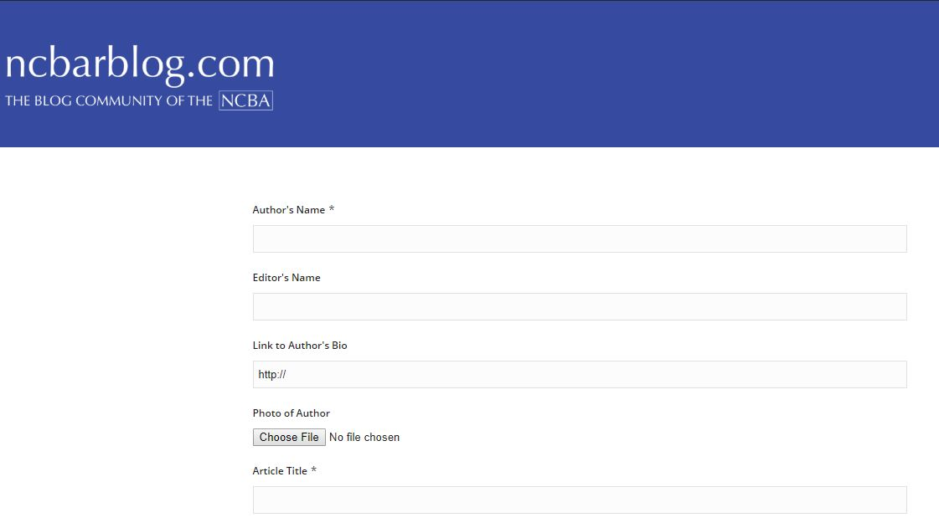
Fill in the blanks.
Tips
If you have submitted an author photo in the past, or know the author is a frequent contributor, you do not need to resubmit a photo.
If you have a pdf to link to from your article, email it to rrawlings@ncbar.org after you submit the post.

Slide 5
Before you hit Submit… Use the pulldown menu at the end of the form to choose your Section or Division.

Slide 6
After you submit your post …
I will receive an email letting me know that it's there.
I will review and adjust the formatting as needed and let you know that the post is ready for your final review and approval.

Slide 7
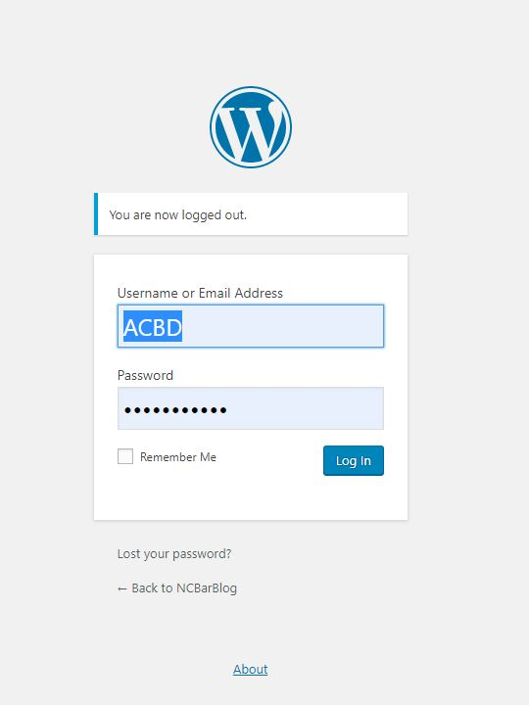
To review your post
Go to https://ncbarblog.com/wp-admin/
Login using your Section or Division user name and the password commchairs1
(Section and Division Communications Chairs will receive their user names in an email.)

Slide 8
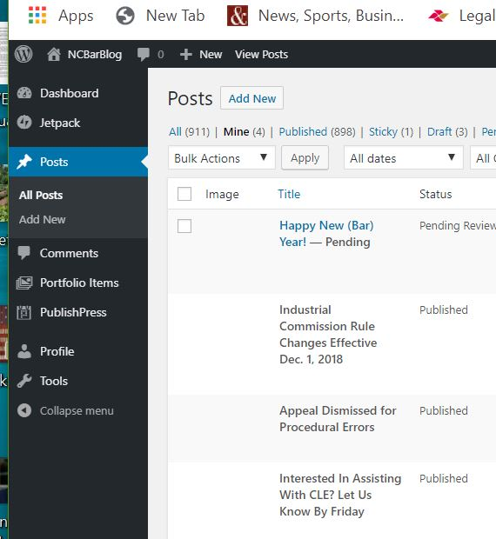
Click on Posts under the heading Dashboard.
You can view, make changes and preview your post.

Slide 9
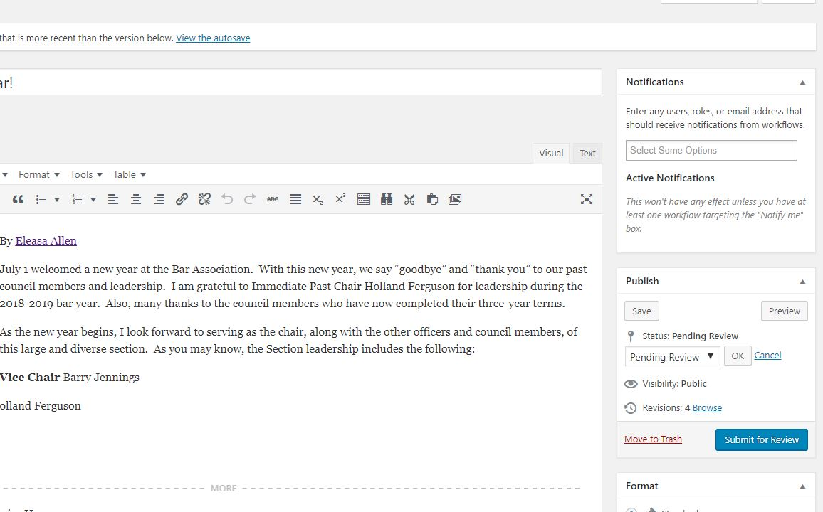
by clicking the blue “Submit For Review“ button on the right side of the screen.
Save your changes …

Slide 10
Send me an email to let me know it’s ready.
I’m at rrawlings@ncbar.org or 919-657-1557 if you need help or have questions about the process.

Slide 11
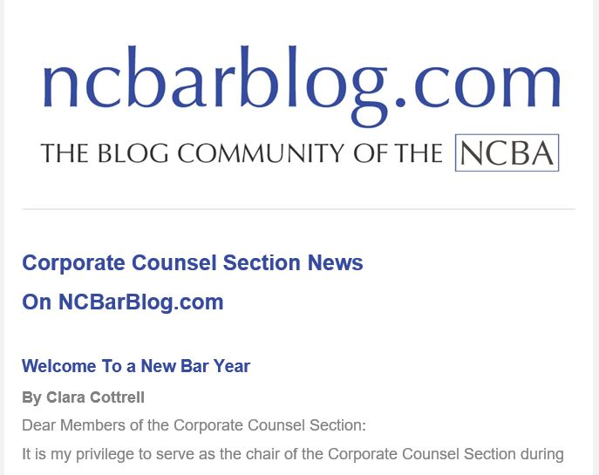
Email notification
I will create and send an email notification of your Section/Division’s latest blog post.
The email will go to all members of the Section/Division. They do not need to subscribe.
The email will come from the address newsletter@ncbar.org. If members do not receive the email, they may want to try adding that address to their address books.

